Slide 1
A Machine Learning Approach to Predict Critical Temperature of Superconductors
Group 7 – Final Team Project
Mohd Sharik | Mohamed Niaz M | Rishabh Malik
Shiely – Marcos School of Engineering, University of San Deigo
AAI-500-A1: Probability and Statistics for Artificial Intelligence
Dr. Ebrahim Tarshizi
June 24, 2024

Slide 2
Abstract
Superconductor materials exhibit zero electrical resistance below their critical temperature (Tc). Higher Tc is preferred due to manageable temperature requirement.
Superconductors can increase energy efficiency in applications such as energy transmission, medical imaging, and quantum computing.
Accurately predicting Tc is enables discovery and design of new superconducting materials with cost-effective material having higher Tc.
Traditional methods for discovering new superconductor material rely on a combination of theoretical calculations and experimental trial-error method to predict Tc.
This study explores the use of machine learning and feature engineering to predict Tc of superconductors based on their elemental properties.

Slide 3
Approach
Utilized dataset (https://archive.ics.uci.edu/dataset/464/superconductivty+dat) from UCI comprising of 21,263 super conductor elements, each characterized by 82 features.
Applied machine learning modeling by selecting 30 most influential features using mutual info regression.
Employed and compared results from multiple regression models such as Linear regression, Random Forest, Gradient Boosting and XGBoost.
The best results are produced by the XGBoost model, after hyperparameter tuning achieving a RMSE of 9.75 on the test set and explaining 91.6% of the variance in critical temperature.

Slide 4
Dataset
21,263 superconductors, each characterized by 82 features.
Target variable: Critical Temperature (Tc)
81 Explanatory variables
Atomic Mass
10 Statistical Measures
8 Elemental Properties
Mean
Weighted Mean
First Ionization Energy
Geometric Mean
Atomic Radius
Weighted Geometric Mean
Density
Entropy
Weighted Entropy
8x10 + 1 = 81
Explanatory Variables
Electron Affinity
X
Range
Fusion Heat
Weighted Range
Thermal Conductivity
Standard Deviation
Valence
Weighted Standard Deviation
Number of Elements
4

Slide 5
Exploratory Data Analysis

Slide 6
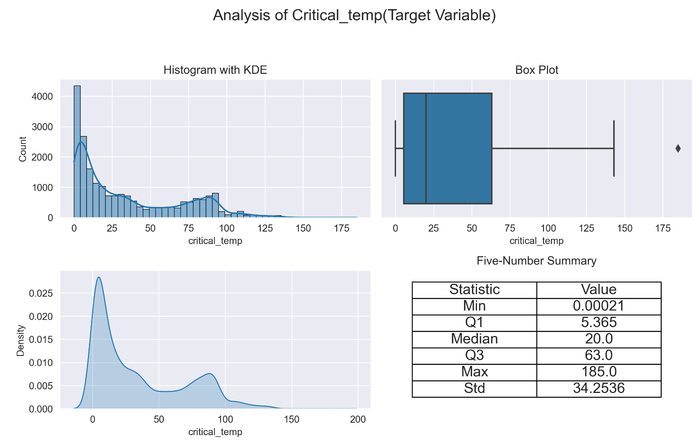
Analysis of Target Variable - Tc
Analyze the target variable critical temperature (Tc​) with histograms, box plots, and KDE plots to understand its distribution.
The table to summarized the data.

Slide 7
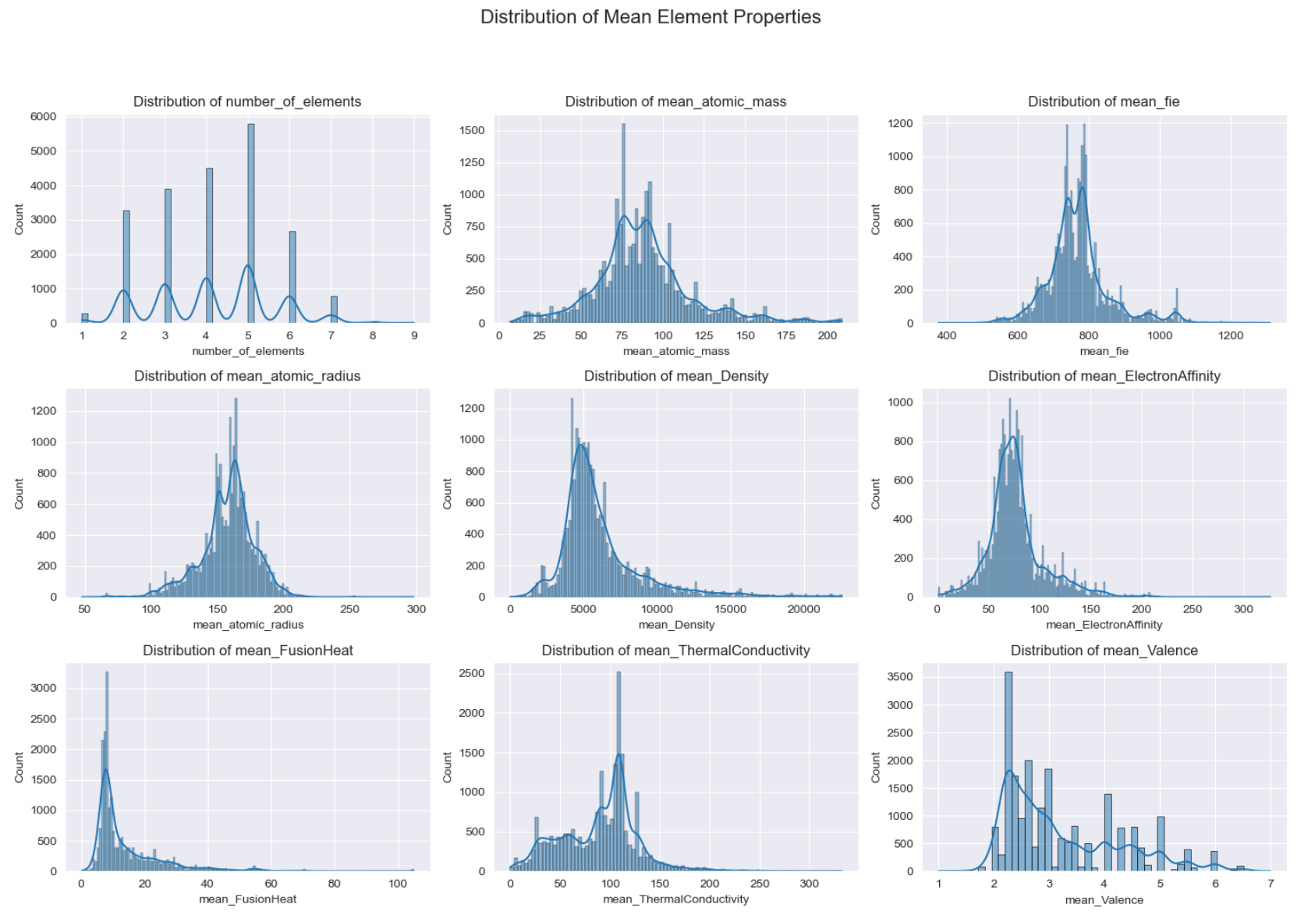
Distribution of Mean Element Properties
Distribution of the mean elemental characteristics are analyzed for normal distribution.
Number of elements and mean thermal conductivity are skewed to the left.
Mean density and mean valence are skewed to the right.
Other variables follow almost normal distribution.

Slide 8
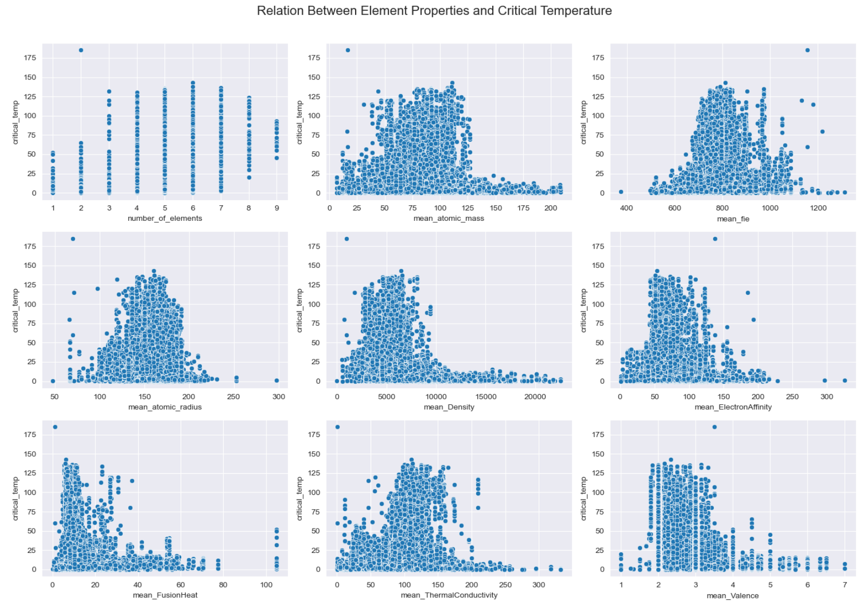
Relationship: Tc vs. Mean Element Properties
Relationship between the target variable and the mean elemental properties was checked with the scatterplot.
The scatter plot indicates moderate non-linear relationship existence between Tc and many of the mean elemental properties.
This hints that linear regression by itself wouldn’t be able to offer an effective model for predicting the critical temperature of superconductor.

Slide 9
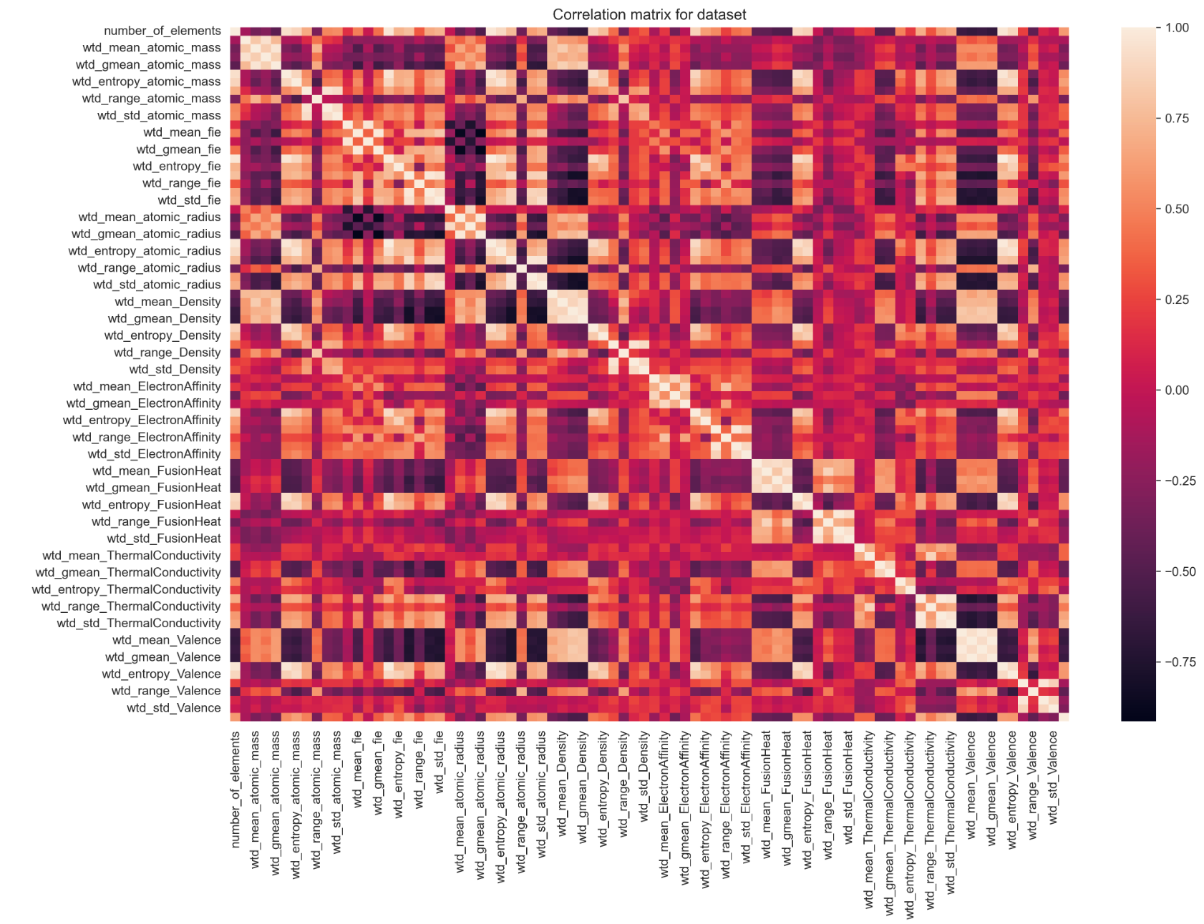
Multicollinearity Assumption Validation
The correlation matrix with heatmap is used to see the relationships among the explanatory variables.
This plot can highlight the level of collinearity existing among the variables.
In view of the multicollinearity, principal component assessment was planned to be tested for effective modeling.

Slide 10
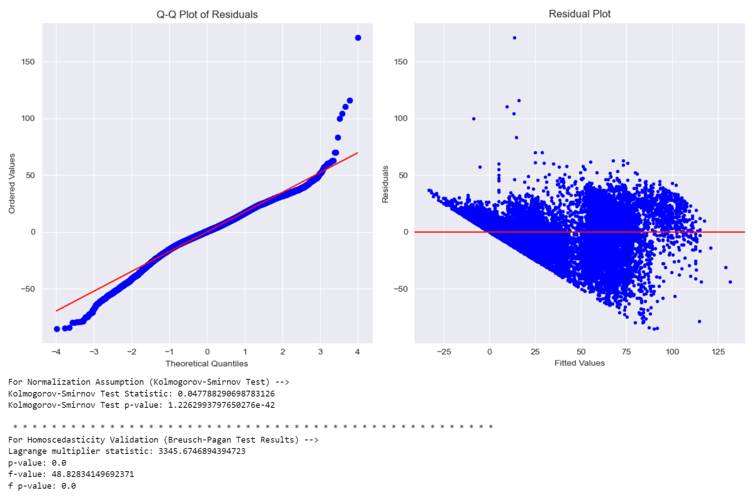
Residual Analysis – Normality & Homoscedasticity
The Q-Q plot explains that residuals are failing the normality assumption.
The residual plot indicated that heteroscedasticity exists in error, failing the homoscedasticity assumption.

Slide 11
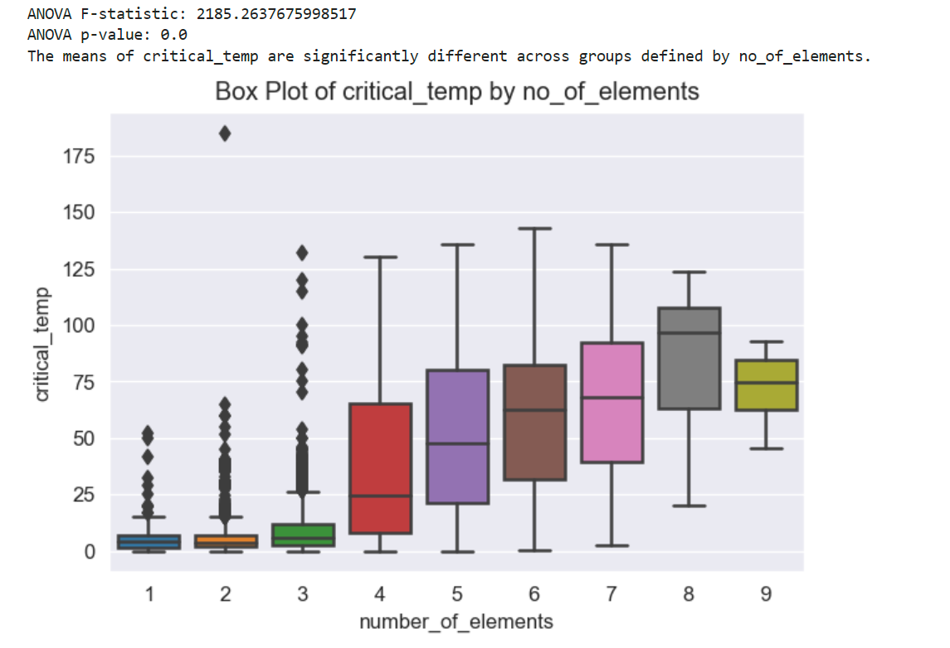
Critical temperature vs. Num of Elements
ANOVA statistical test to compare means across number of elements in superconductors.
We found that it does have a significant effect.

Slide 12
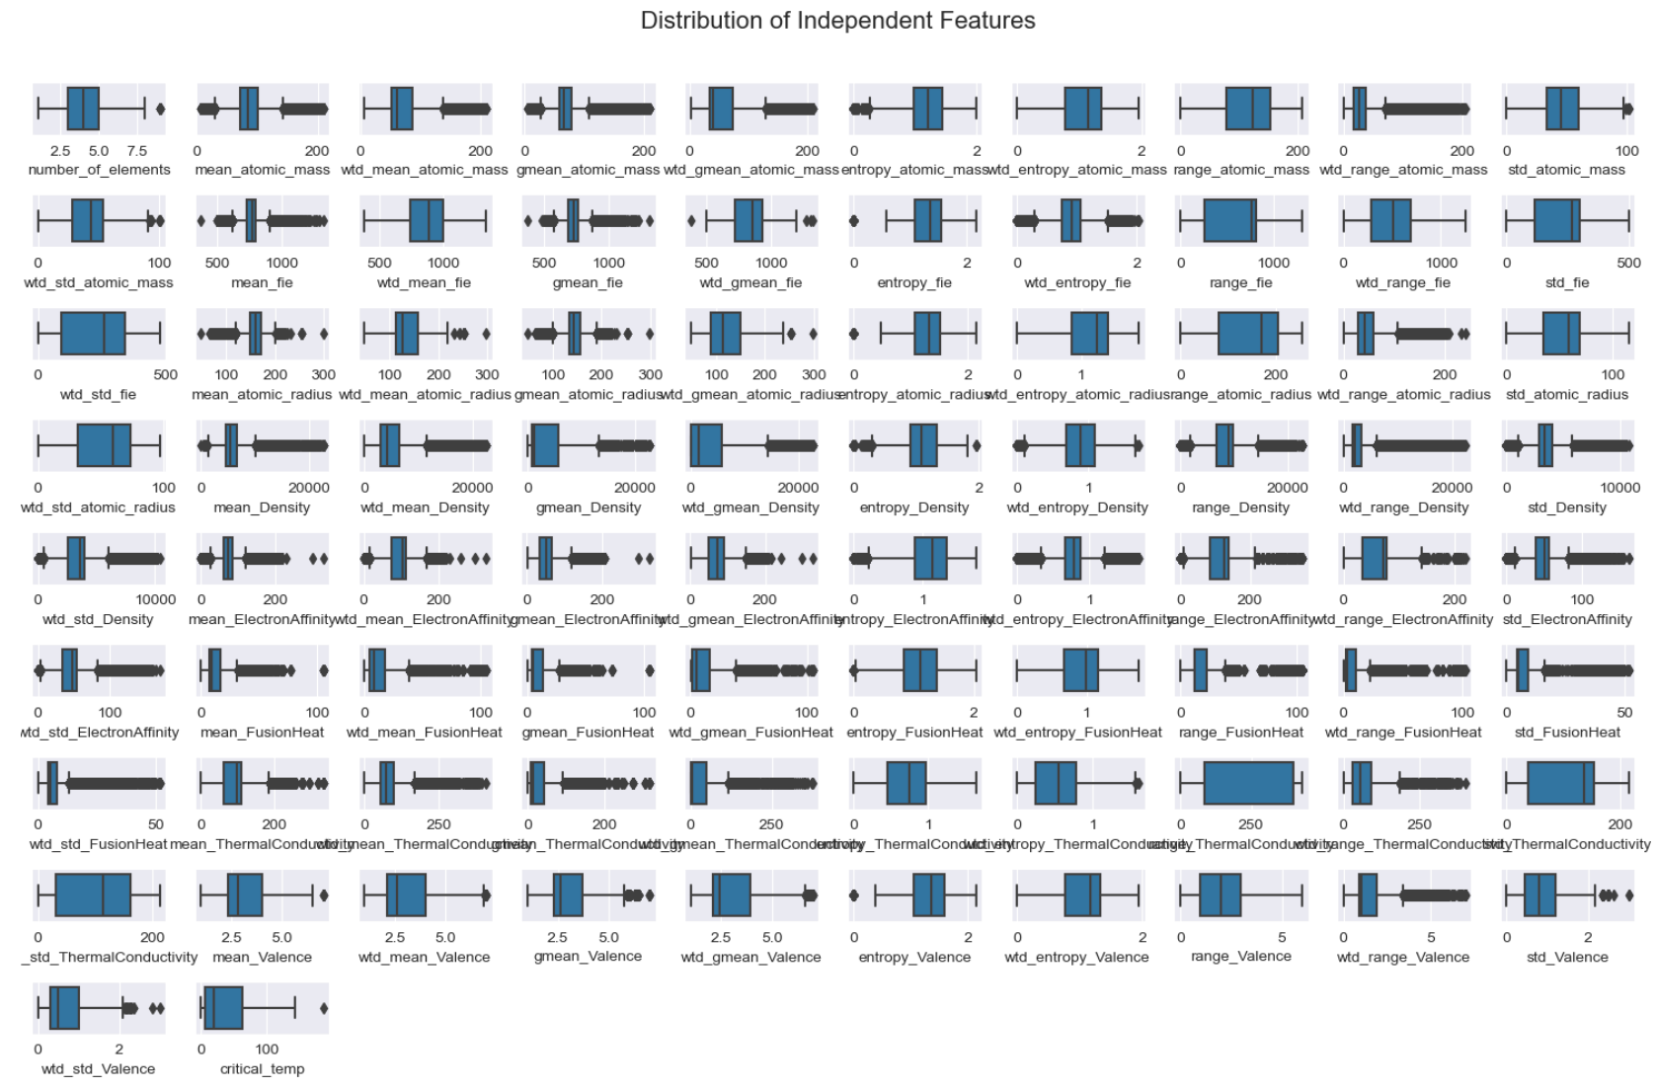
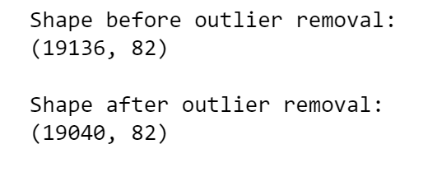
Outlier Analysis
Distribution of features analyzed using box plots.
Outliers may cause problems in analysis. Few outliers are removed.

Slide 13
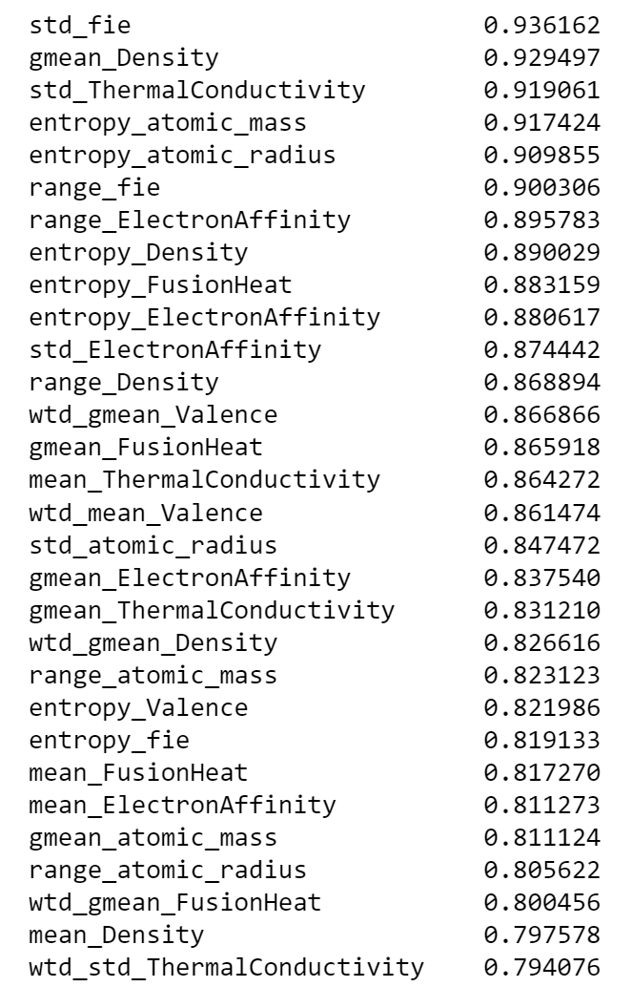
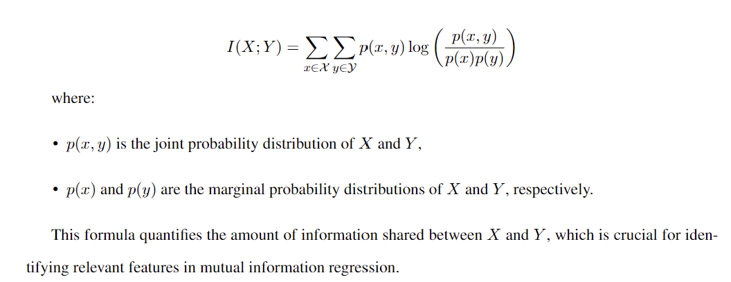
Feature Selection
To Reduce dimensionality and achieving effective performance with employed mutual info regression score to select top 30 features.

Slide 14
Model Selection

Slide 15
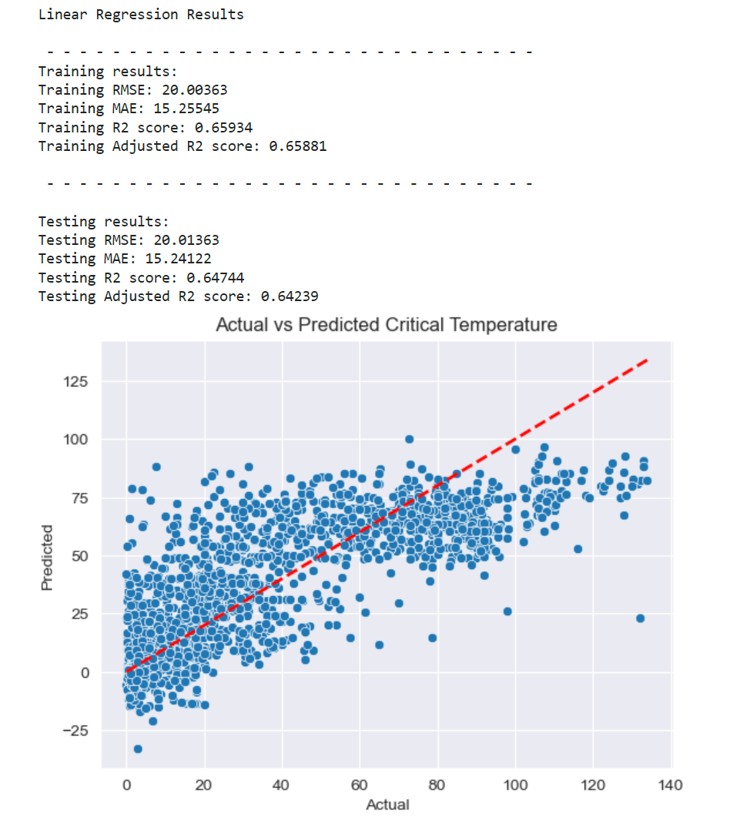
Simple Linear Regression
Basic linear model that assumes a linear relationship between the features and the target variable has been fit.
R2 results are not sufficient due to the non-linear relationship between target and explanatory variables.

Slide 16
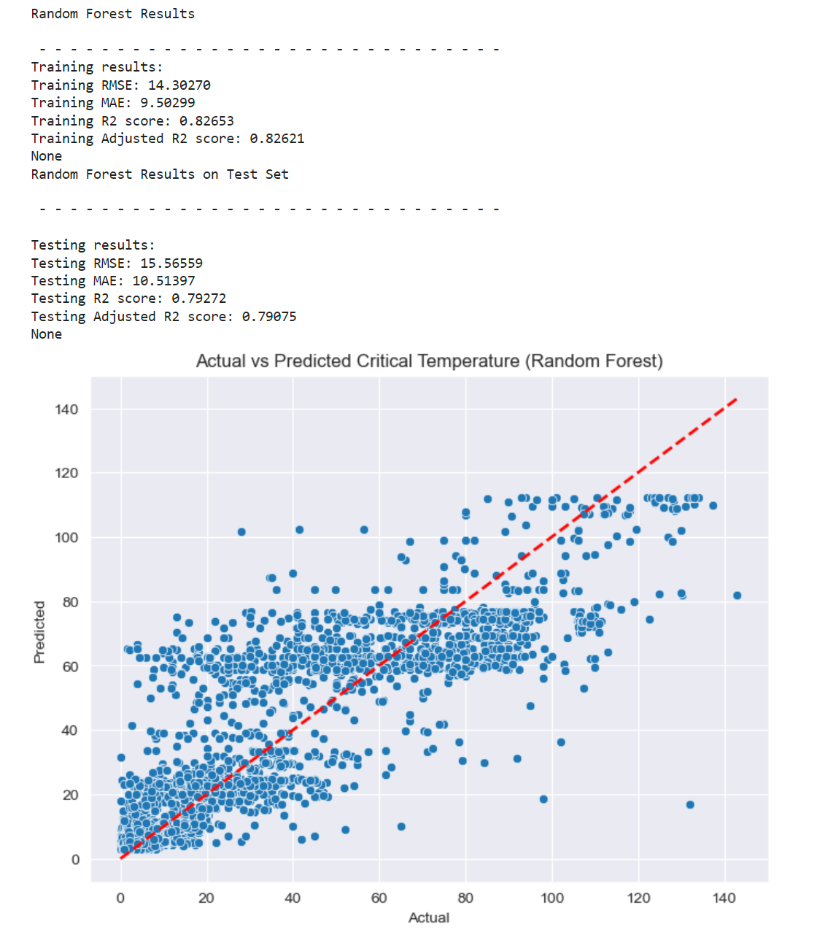
Random Forest
Ensemble learning method that constructs a multitude of decision trees and outputs the mean prediction of the individual trees.

Slide 17
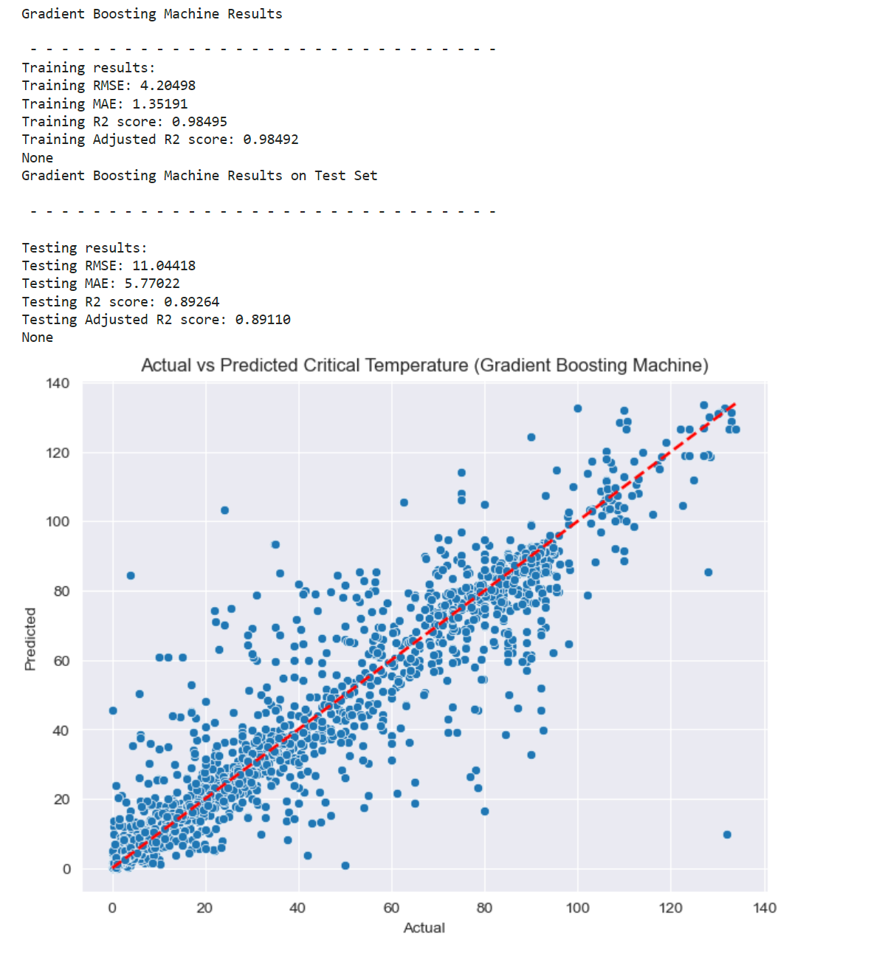
Gradient Boosting Regressor
Gradient boosting algorithm known for its speed and performance
Often used in winning solutions for machine learning competitions.

Slide 18
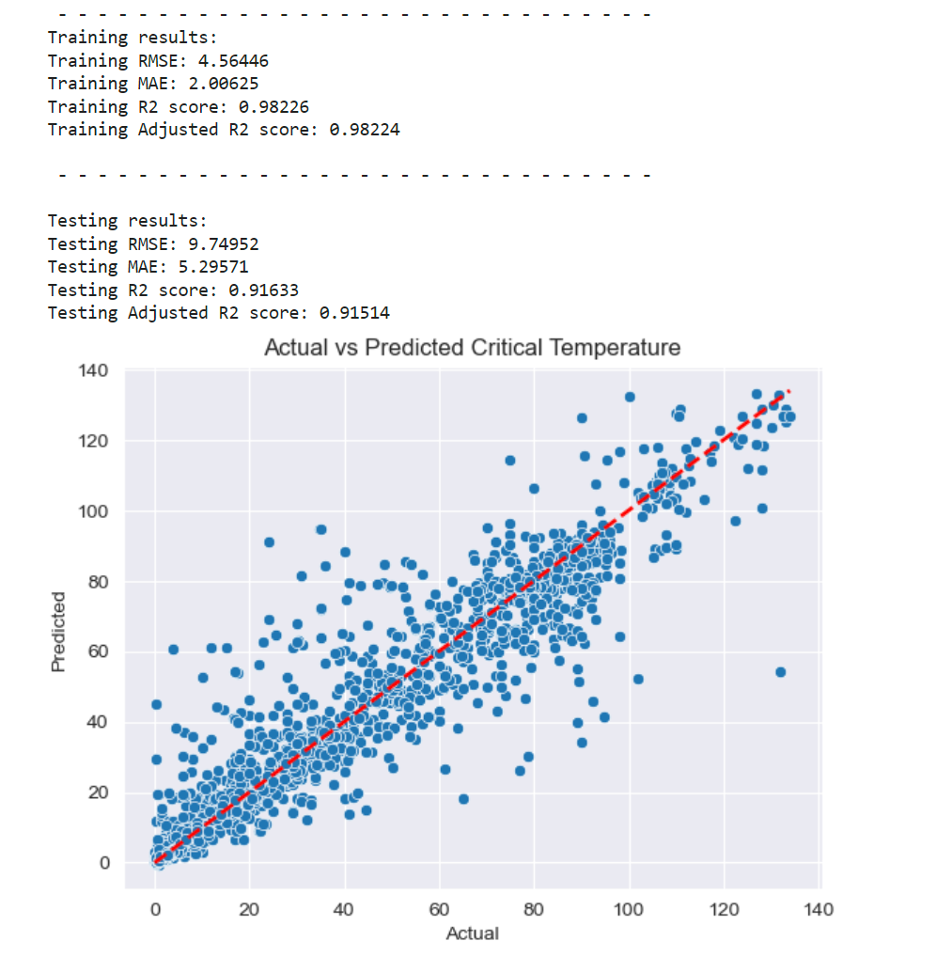
XGBoost Model- Winner of The Race
Selection of optimal parameters for the ML Model
learning_rate: Step size shrinkage used to prevent overfitting. Range: 0.001 to 0.25.
max_depth: Maximum depth of each tree. Range: 6 to 20.
n_estimators: Number of trees in the ensemble. Range: 700 and 1500.
subsample: Fraction of the training data used for each tree. Values: 0.25, 0.5, and 0.75.
reg_lambda: L2 regularization term on weights Values: 0.1, 0.5, 1.0, and 1.5.

Slide 19
Challenges
Linear regression and GLM models being parametric had upper cap in explainable variability.
Nonparametric ensemble models offered relatively better performance without any assumptions on the underlying data.
Computational resource limitations remain a challenge, as improving model performance often requires computationally expensive hyperparameter tuning processes.

Slide 20
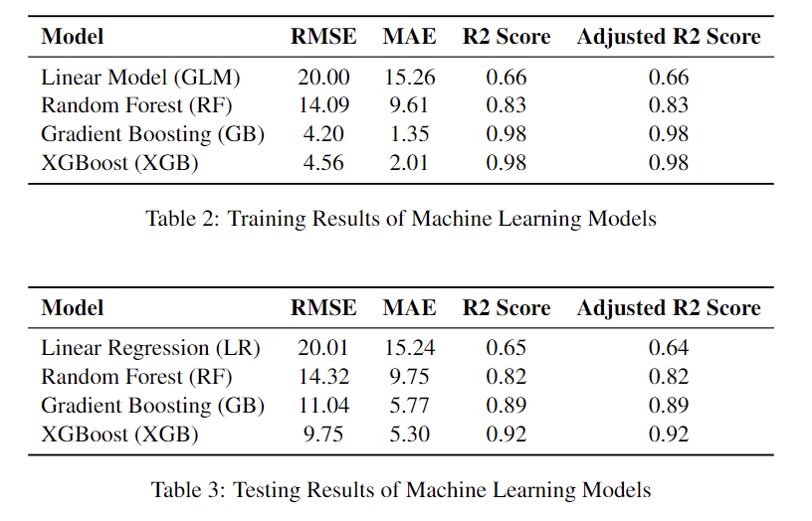
Conclusion
Temperature control (Tc) of the conductor is the key challenge in application of Superconductor. This model can help the scientists to synthesize superconductor materials that suit Tc achievable at target environment.
XGBoost Machine learning with GridSearchCV hyperparameter tuning predicted the critical temperature with R2 score of 91.63%

Slide 21
Thank You

